Slide 1

RUNGTA COLLEGE OF DENTAL SCIENCES & RESEARCH
TITLE OF THE TOPIC-
ANCHORAGE IN ORTHODONTICS
DEPARTMENT OF ORTHODONTICS AND DENTOFACIAL ORTHOPAEDICS

Slide 2
Specific learning Objectives
CORE AREAS | DOMAIN | CATEGORY
CLASSIFICATION OF ANCHORAGE | COGNITIVE | MUST KNOW
INTRAORAL SOURCES OF ANCHORAGE | COGNITIVE | NICE TO KNOW
EXTRAORAL SOURCES OF ANCHORAGE | COGNITIVE | NICE TO KNOW
TYPES OF ANCHORAGE | COGNITIVE | MUST KNOW
USE OF IMPLANTS OR TEMPORARY ANCHORAGE DEVICE(TAD) | PSYCHOMOTOR | DESIRE TO KNOW
ANCHORAGE PLANNING | COGNITIVE | DESIRE TO KNOW
LOSS OF ANCHORAGE | COGNITIVE | DESIRE TO KNOW

Slide 3
CONTENTS
PART I
INTRODUCTION
CLASSIFICATION OF ANCHORAGE
INTRAORAL SOURCES OF ANCHORAGE
EXTRAORAL SOURCES OF ANCHORAGE
TYPES OF ANCHORAGE
PART II
TYPES OF ANCHORAGE
USE OF IMPLANTS OR TEMPORARY ANCHORAGE DEVICE(TAD)
ANCHORAGE PLANNING
LOSS OF ANCHORAGE

Slide 4
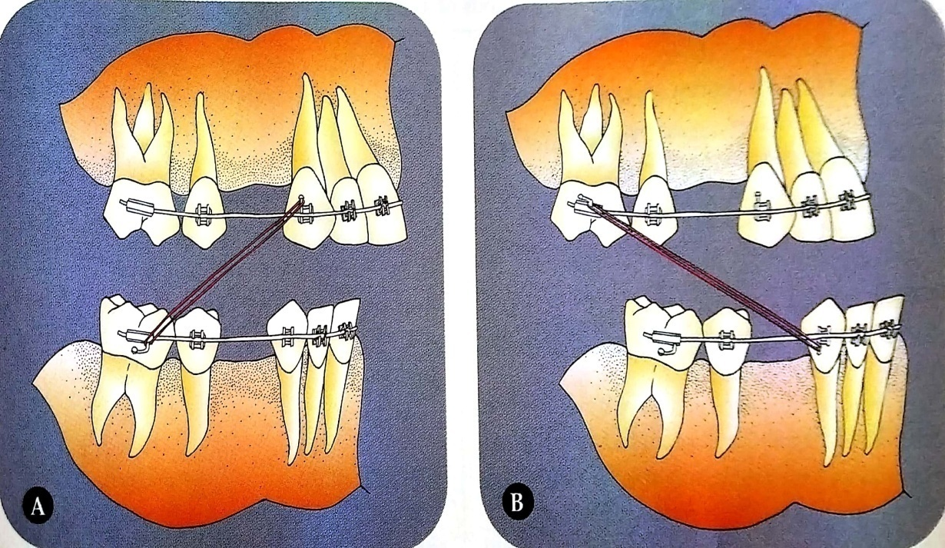
INTER MAXILLARY ANCHORAGE
Anchorage in which the resistance units situated in one jaw are used to effect tooth movement in the opposing jaw.
It is also termed as
Baker’s anchorage.

Slide 5
SINGLE OR PRIMARY ANCHORAGE
The resistance provided by a single tooth with greater alveolar support is used to move another tooth with lesser support.
Eg. Molar being used to retract a premolar.

Slide 6
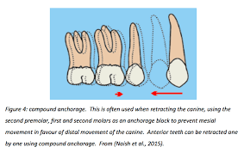
COMPOUND ANCHORAGE
Anchorage where the resistance provided by more than one tooth with greater support is used to move teeth with lesser support.

Slide 7
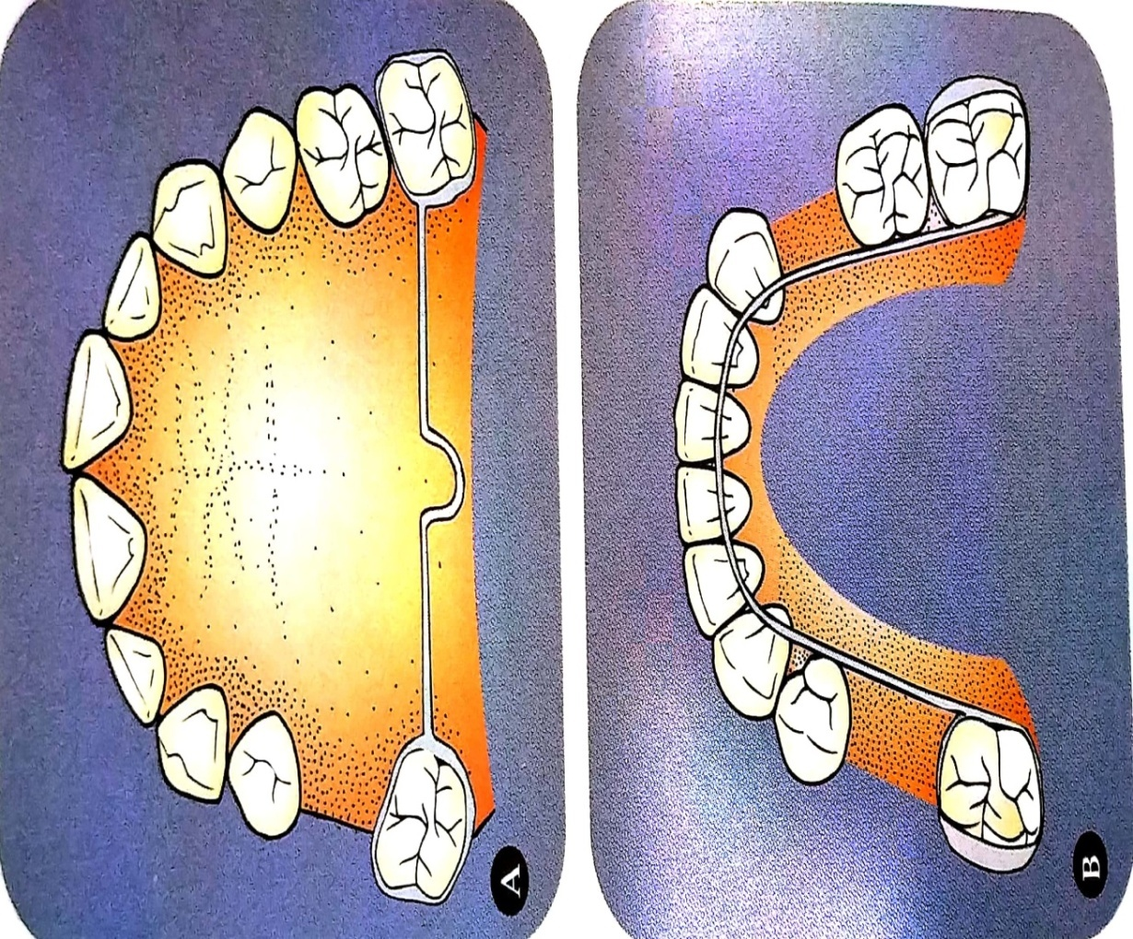
REINFORCED OR MULTIPLE ANCHORAGE
Anchorage in which more than one type of resistance unit is utilized.
Methods of reinforcing anchorage:-
Extraoral forces to augment anchorage
Upper anterior inclined plane
Use of transpalatal arch and lingual arch

Slide 8
USE OF IMPLANTS OR TEMPORARY ANCHORAGE DEVICE (TAD)
These devices are especially useful in patients who have lost lot of teeth or hypodontia.
Endosseous implants are a valuable alternative for stable intra oral anchorage.
Temporary anchorage device also known by the terms such as mini-implant, mini-screws, skeletal anchorage devices or micro-screws.
.

Slide 9
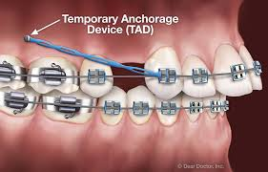
TAD is a device that is temporarily fixed to the bone for the purpose of enhancing orthodontic anchorage either by supporting the teeth of reactive unit or by obviating the need for reactive unit altogether.

Slide 10
INDICATIONS OF TEMPORARY ANCHORAGE DEVICE
Mesial and distal movement of buccal teeth.
Lingual or labial movement of anterior teeth.
Vertical intrusive movement of buccal or anterior teeth.
In patients whose posterior teeth are missing .
As anchorage for distalization of molars.

Slide 11
For intrusion of maxillary teeth.
Anterior open bite and deep bite.
Source of anchorage for retraction of canine and anteriors.
Correction of canted occlusal planes.
As an aid in the treatment of class III malocclusion.

Slide 12
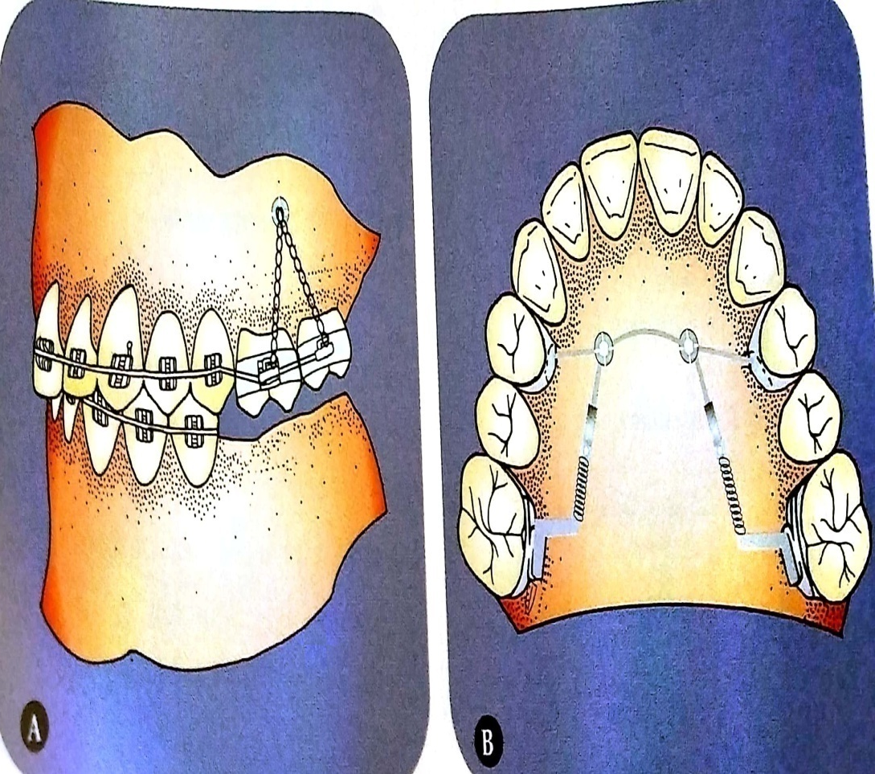
Maxillary molar intrusion.
Anchorage during distalization.

Slide 13
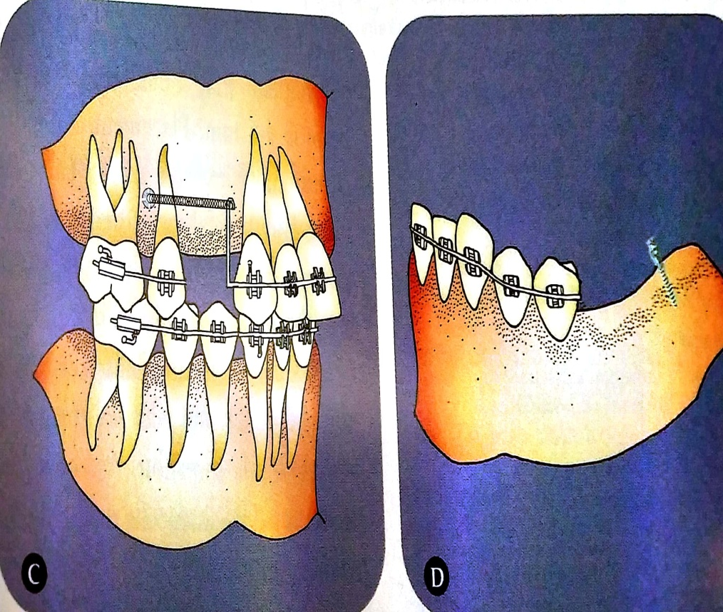
C .Retraction of anterior teeth.
D. Anchorage when posterior teeth are missing.

Slide 14
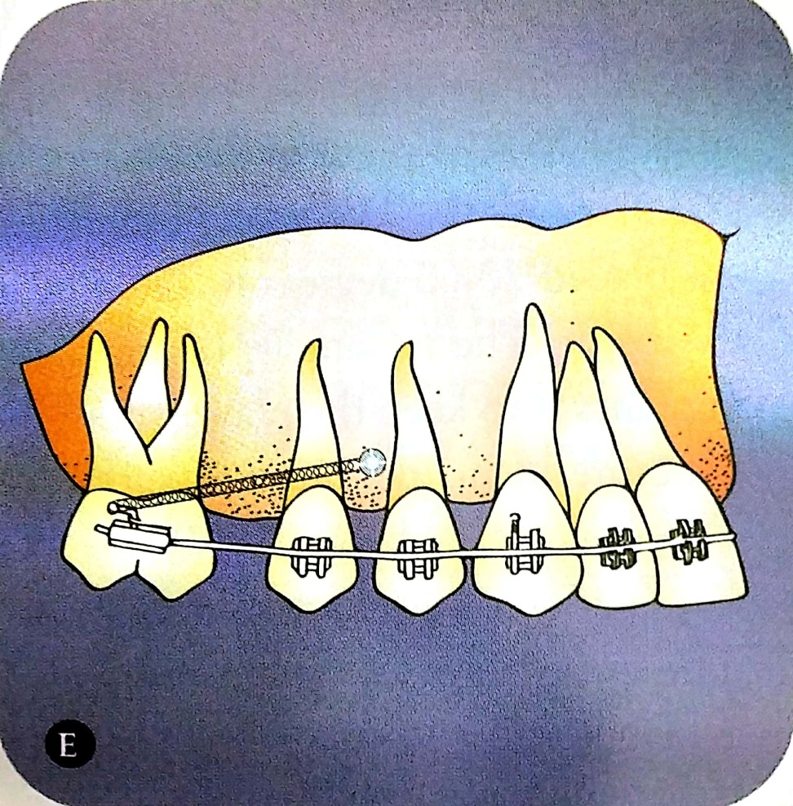
E. Mesial movement of second molar.

Slide 15
COMPLICATIONS OF TAD
Contact with adjacent roots.
Breakage of implant.
Damage to anatomic structures.
Soft tissue overgrowth.
Implant loosening.

Slide 16
ANCHORAGE PLANNING
Anchorage planning is of utmost importance for the success of orthodonic treatment.
It is essential to carefully assess the anchorage demands of an individual case so that appropriate treatment modalities can be executed.

Slide 17
The anchorage requirement depends on a number of factors which are listed below:-
Number of teeth being moved
Type of tooth movement
Duration of tooth movement
Duration of tooth movement
Skeletal pattern
Occlusal interlock

Slide 18
LOSS OF ANCHORAGE
Unplanned and unexpected movement of the anchor teeth during orthodontic treatment.
Causes of loss of anchorage are:-
Poor appliance design.
Poor appliance adjustment.
Poor patient wear.

Slide 19
summary
For understanding anchorage, it is convenient to divide anchorage into—intraoral and extraoral anchorage. Further, intraoral anchorage can be subdivided into intramaxillary and intermaxillary anchorage. Both can be of three types—simple, stationary or reciprocal.
Simple anchorage can be further subdivided as— single, compound and reinforced.
Extraoral anchorage can be of the following types depending upon the location of the support units as— cervical, occipital, cranial or facial.

Slide 20
REFERENCES
Textbook of Orthodontics – Gurkeerat Singh, Jaypee Brothers; 2nd Edition
Orthodontics – The Art and Science, S.I Bhalajhi, AryaMedi Publishing; 7th Edition
Textbook of Orthodontics – Sridhar Premkumar, Elsevier; 1st Edition
Orthodontics: Diagnosis and Management of Malocclusion and Dentofacial Deformities – O.P Kharbanda, Elsevier; 1st Edition

Slide 21
Question & Answer Session

Slide 22
THANKYOU!!!

